Slide 1
Cooking Recipe Portal
DataBase Project

Slide 2
Group2
Lê Thanh Hải – 20184254
Bùi Nguyễn Bảo Ngọc - 20176837

Slide 3
AGENDA
INFOGRAPHIC
Introduce to Project
Database Design
Application Design

Slide 4
1.Introduce Project
Cooking Recipe Project
Overview
The project contains many popular and delicious Vietnamese Food Recipe that help yourselves to have necessary knowledge about preparing and cooking food.
Easy to follow and understand the recipe.
Useful for who lack of cooking experience.
Explore many delicious food.
Share experience with the others.

Slide 5



2.Database Design
Dish
Name
Ingredients
Instruction
Note
Difficulty
Pros & Cons
Category(Bake,Fish…)
Name
Number of food
Special Food
Name
Number of food
Rating
Authors
Name
Number of recipe
Rating

Slide 6


2.Database Design
Users
Authors
Login Account
Save & Print Recipe
Comment
Rate
Post Recipe
Share experience

Slide 7
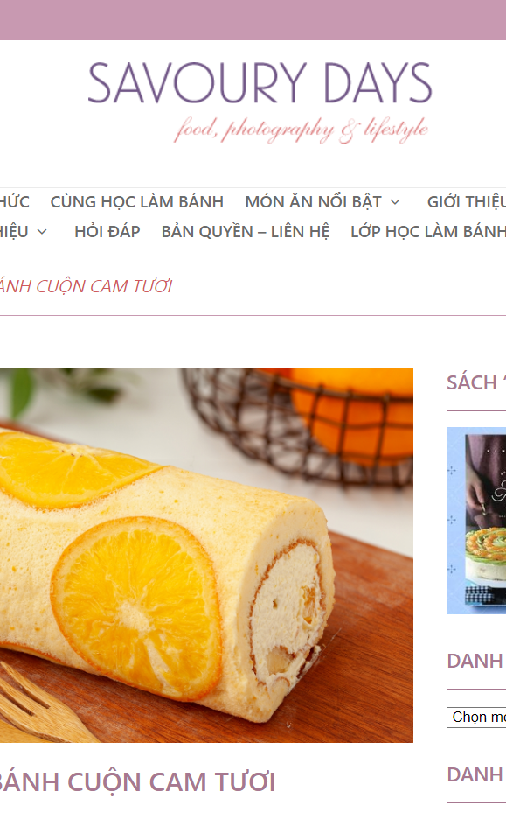
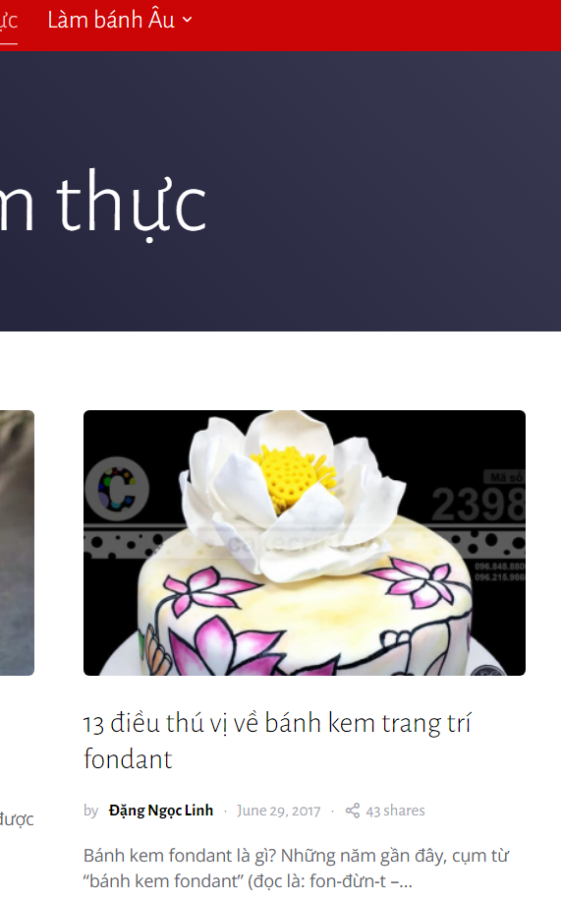
3.Application Design
Web Design
http://www.savourydays.com/
CHIEF CHEF

